Slide 1
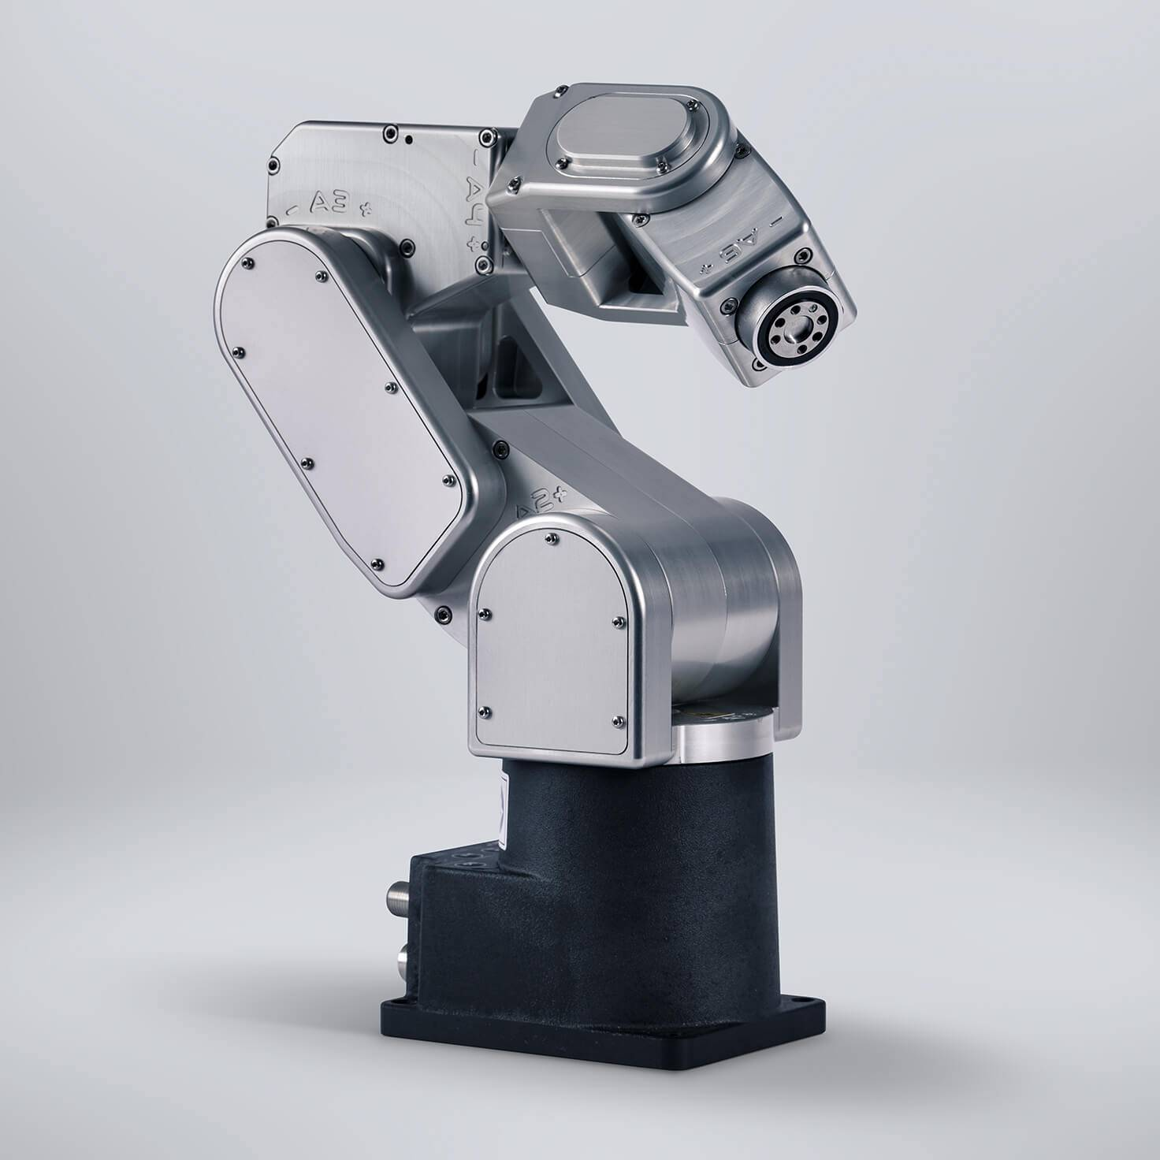
TicTacToe
TicTacToe with Robot Arm
Li Lin
Zhaofeng Tian
Group 8
Advisor: Prof. Pandya

Slide 2
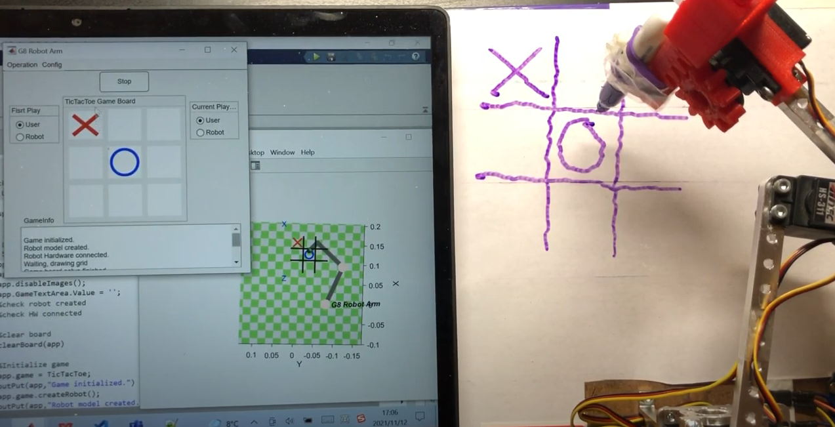
Introduction
In this project, we design a Robot Arm that can play the TicTacToe game with human users and demonstrate the corresponding simulator in the Matlab GUI. Moreover, a game strategy designed can guarantee a win or tie for the robot.
Check the link to watch full demo:
video

Slide 3
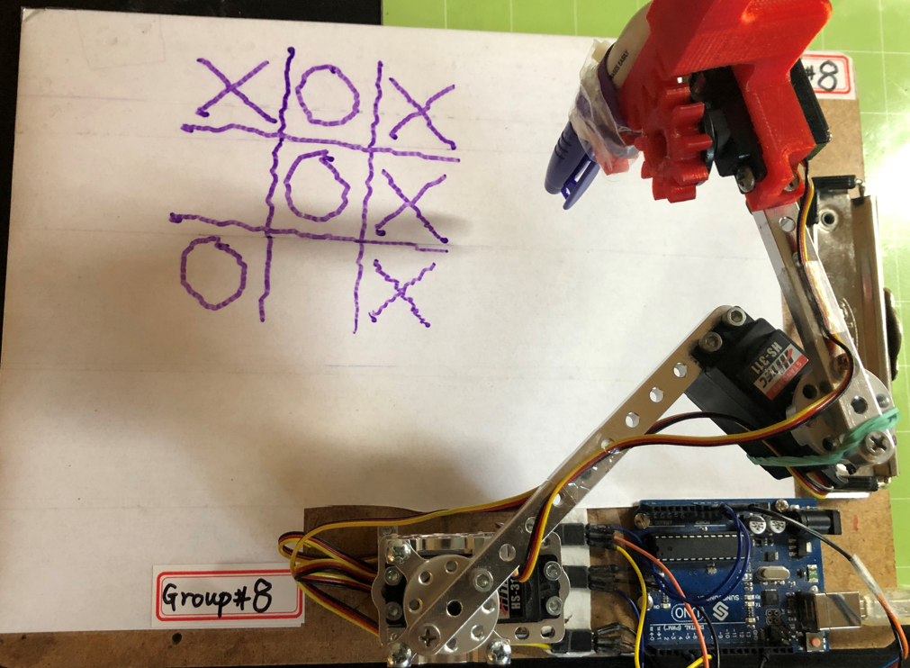
Hardware

Slide 4
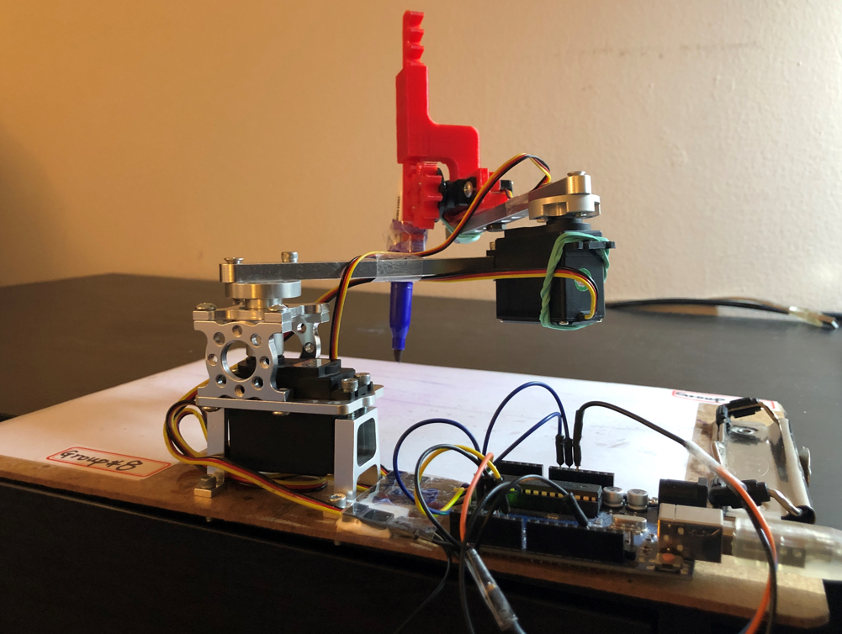
Hardware
Hardware improvement
Standard Hub Shaft ServoBlock

Slide 5
Methods: How to move EE
A
B
(X₀, Y₀, Z₀)
(X_{f}, Y_{f}, Z_{f})
%use fkine with initial q0 to get initial position
T0 = robot.fkine(q0);
%change the position para to final position para
T0.t(1) = X_{f};
T0.t(2) = Y_{f};
T0.t(3) = Z_{f};
%use ikine to get final position joint angles
qf = robot.ikine(T0, “q0”, q0, “mask”, [1 1 1 0 0 0]);
%use plot() with qf to move EE
robot.plot(qf)
Moving End-effector from one place to another is basic for this project

Slide 6
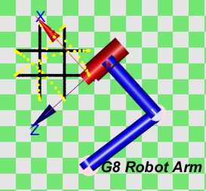
Methods: Move EE smoothly
The below are some functions about trajectory generation used in moving the EE.
[qx,qd,qdd]=mtraj(@tpoly, q0, qf, 8); is a trajectory generation function using polynomial method.
[Q,QD,QDD] = mtraj(TFUNC, Q0, QF, M) is a multi-axis trajectory (MxN) varying from state Q0 (1xN) to QF (1xN) according to the scalar trajectory function TFUNC in M steps.
[S,SD,SDD] = tpoly(S0, SF, M) is a scalar trajectory (Mx1) that varies
smoothly from S0 to SF in M steps using a quintic (5th order) polynomial.
The yellow points are the moving trajectories instead of drawing lines.

Slide 7
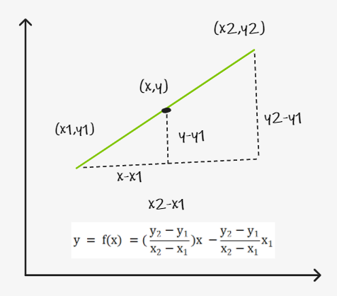
Methods: How to draw a line
To draw a straight line from one point to another, we need to interpolate the line
Vertical or Horizontal Line
x = linspace(x1, x2, 40)
y = linspace(y1, y2, 40)
points = [x;y]’
Not Vertical or Horizontal Line
x = linspace(x1, x2, 40)
y = f(x)
points = [x;y]’

Slide 8
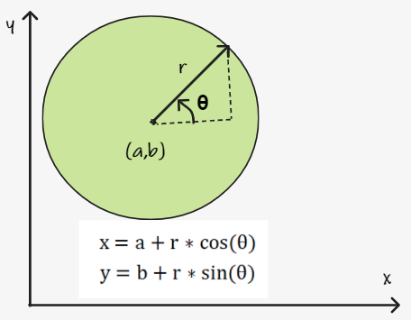
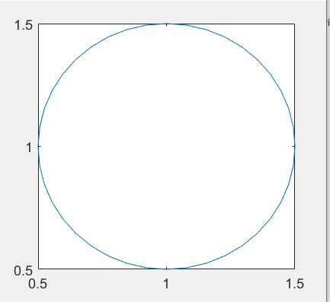
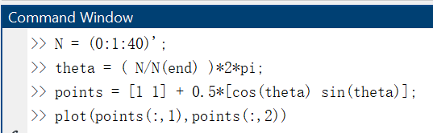
Methods: How to draw circle
N = (0:1:40)';
theta = ( N/N(end) )*2*pi;
points = ([a b] + r*[cos(theta) sin(theta)];

Slide 9
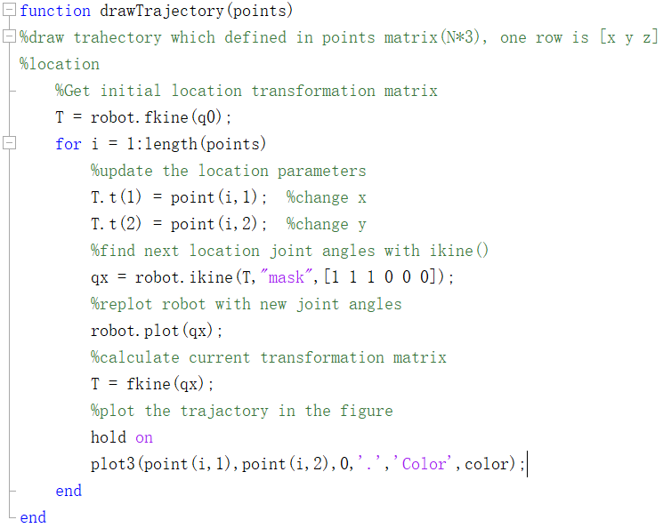
Methods: How to draw the trajectory
Basic logic to draw trajectory

Slide 10
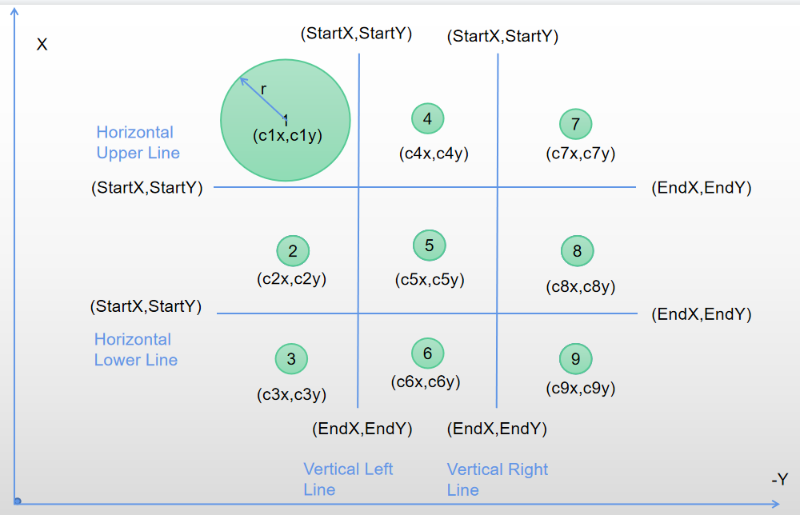
Methods: Define the game board

Slide 11
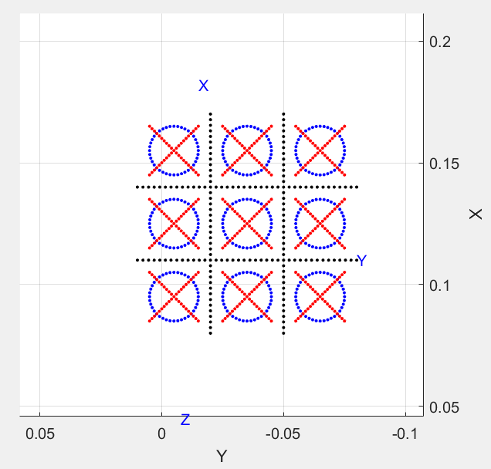
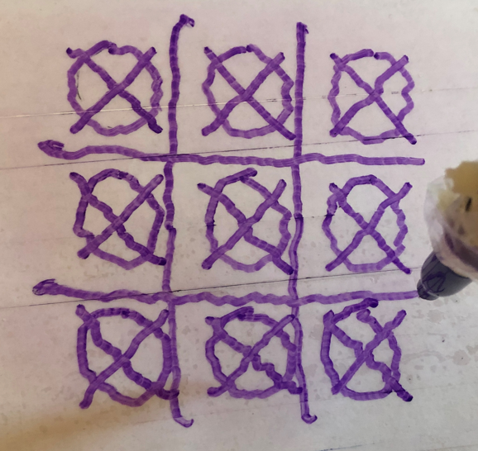
Methods:Actual drawing
Simulation

Slide 12
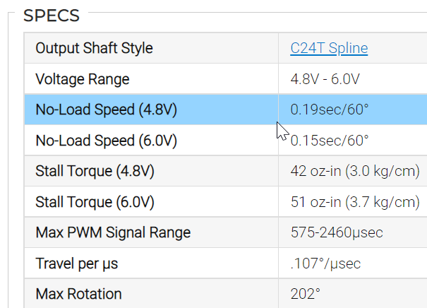
Methods: Convert joint angle to motor angle
JointAngle
(qlimMax - angle)/(qlimMax+qlimMin)
MotorAngle
Angle(º) | Motor
-90º | 1
0º | 0.554
112º | 0
qlim = [-90 112]
0º
112º
-90º
Joint

Slide 13
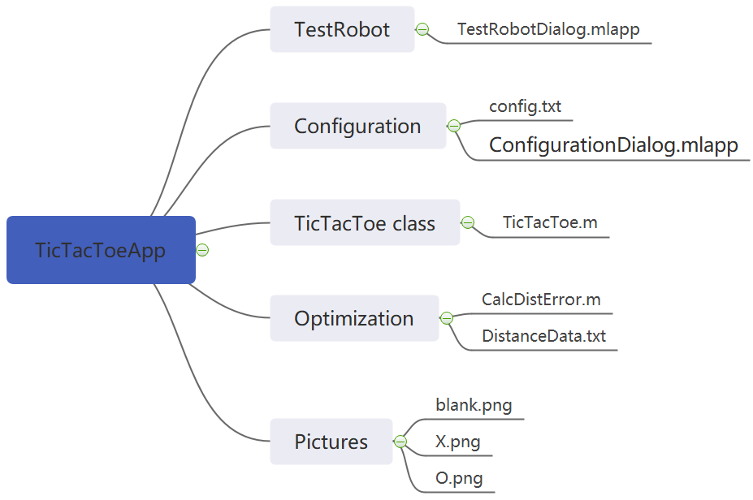
Implementation: Project Structure

Slide 14
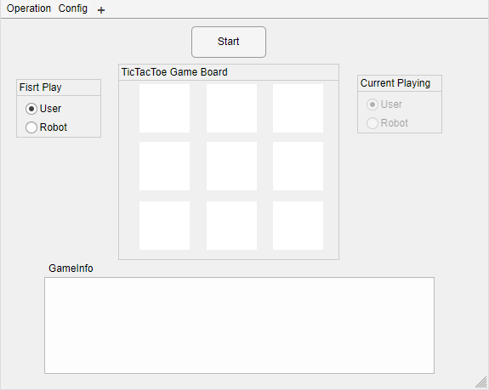
Implementation: TicTacToe App

Slide 15
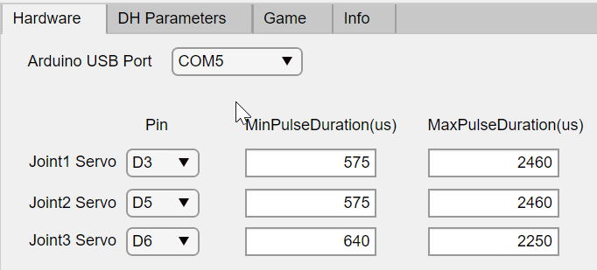
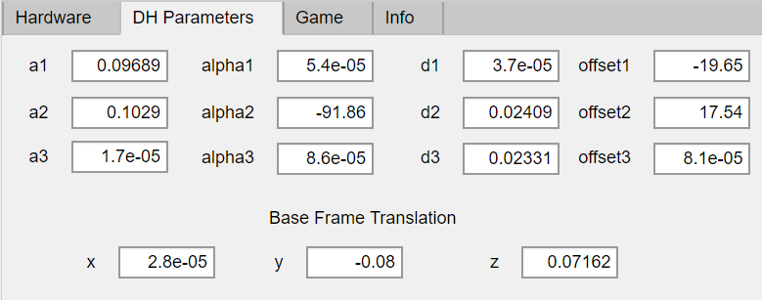
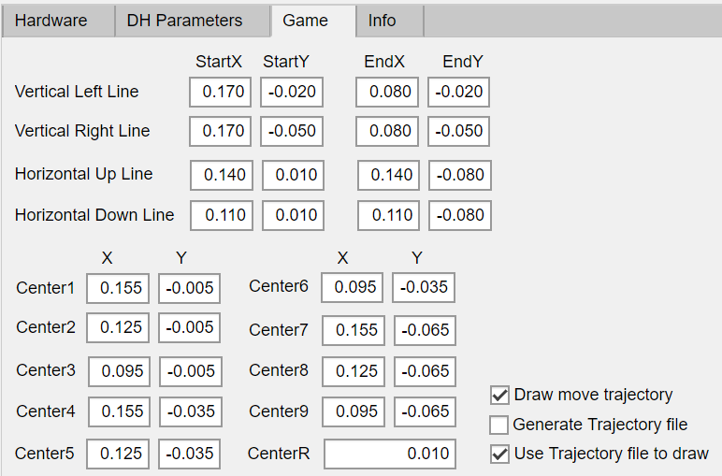
Implementation: Configuration Dialog

Slide 16
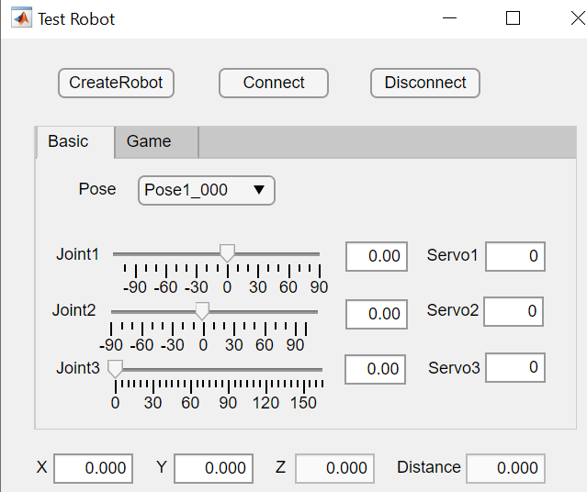
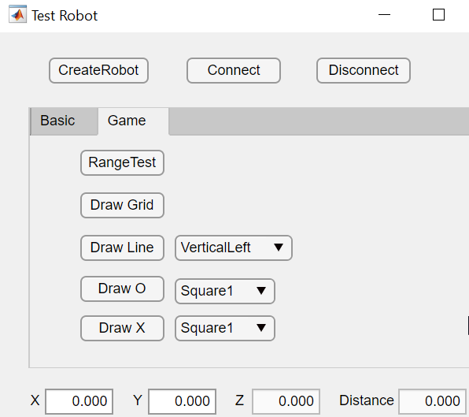
Implementation: TestRobotDialog

Slide 17
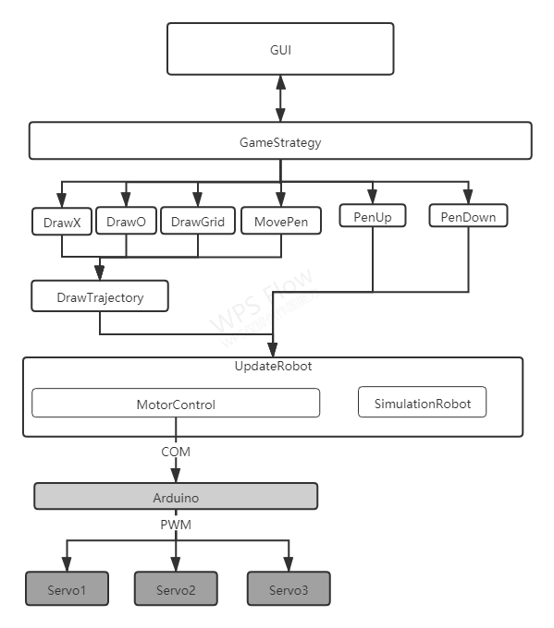
Implementation: Design Structure

Slide 18
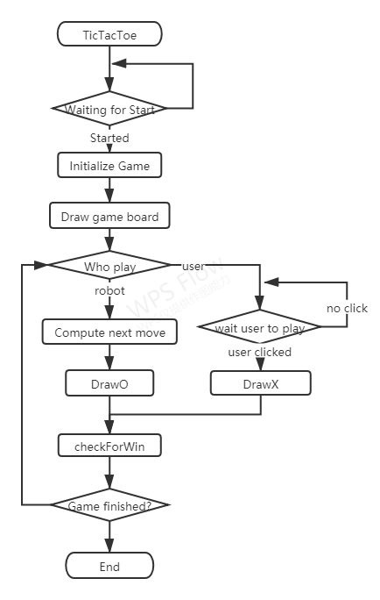
Implementation: Main App Flowchart

Slide 19
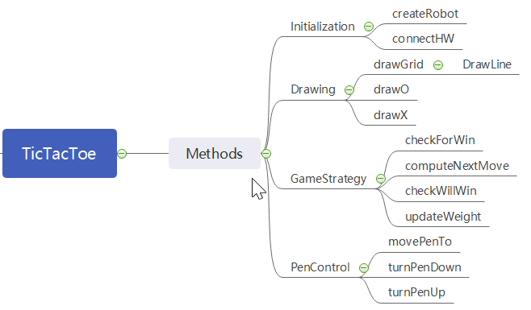
Implementation: TicTacToae Class Methods

Slide 20
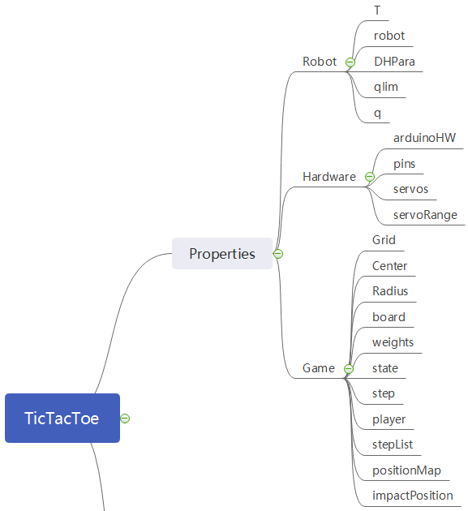
Implementation: TicTacToae Class Properties

Slide 21
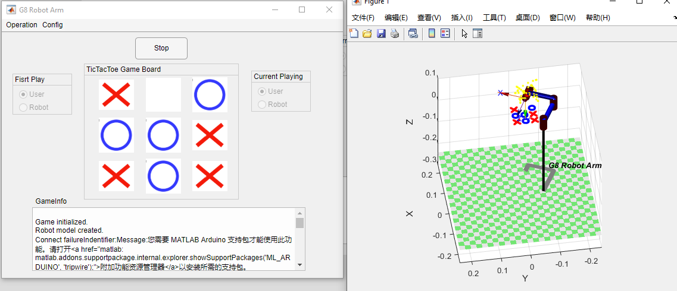
Implementation: Game Window
The picture below shows a sample game. As we can see, the robot in the simulator can draw O and X with a designed strategy which will be explained in the later slides.

Slide 22

Implementation: Robot not lose strategy
Basic logic:
1. Frist 4 steps are very important, corner cell is the best, center cell is good as well, edge cell( 2 4 8 6 )is the last choice. We design the very specific steps for the first 4 steps.
2. From step4:
2.1 Select the position which robot could win within one step;
2.2 Select the position which user could win within one step;
2.3 Select the position which has highest weight for robot
2.4 Select the position which has highest weight for user
2. 5 Randomly choose highest weight for next position
Game board position
Initial weight for both
1
4
7
3
2
3
2
5
8
2
4
2
3
6
9
3
2
3

Slide 23
Implementation: Robot not lose strategy
Step1: User plays at position1
Game board position
X
4
7
2
5
8
3
6
9
Weight Change for user
Weight Change for robot
Change weight to 0 because it is not empty
0
2
3
0
1
2
Impacted position weight -1
2
4
2
1
3
2
3
2
3
2
2
2

Slide 24
Implementation: Robot not lose strategy
Step2: Robot plays at position5
Game board position
X
4
7
2
O
8
3
6
9
Weight Change for user
Weight Change for robot
0
1
2
0
1
2
Impacted position weight -1 for opponent
Change weight to 0 because it is not empty
1
0
1
1
0
2
2
1
2
2
2
2

Slide 25
Discussion
In this project, we learned how to connect the robot with Arduino board and how to control the servo motor via the Matlab/Arduino interface. And most importantly, we practice programming skill to implement several functionalities on this robot arm which include the TicTacToe game playing and decision-making policy. Finally, our robot arm can play TicTacToe game with a human player and never lose in the game.
Thanks to professor. Pandya!
If you have further question, please reach us out.

Slide 26
Appendix
Video: https://www.youtube.com/watch?v=j4RMDoQk3Zw
Code: https://github.com/linliawxm/RobotArm/tree/main/Project2

Slide 27
Contribution
Li Lin: Hardware setup, software setup, main App design, soft ware programming and testing, making the video and providing resources for the slides.
Zhaofeng Tian: testing software, TicTacToe game strategy design, slides work.

